Slide 1



TRUELACROSSE.COM
2026
All-Region Games
Parent Guide and Event Overview

Slide 2



TRUELACROSSE.COM
All-Region Games 2026

Slide 3

TRUELACROSSE.COM
The Event
True Lacrosse’s All-Region Games offers an exclusive, multi-day, invitation-only experience that unites the top rising youth and high school lacrosse players from across the nation. This event is designed to foster a highly competitive environment, where players can showcase their skills, gain invaluable exposure, and connect with collegiate coaches. Whether competing in tournament-style play or participating in showcase events, players will experience a high-profile atmosphere like no other, ensuring that every moment counts.
All-Region Games 2026

Slide 4
TRUELACROSSE.COM
All-Region Games
January 17th & 18th, 2026
Naples, Florida
Paradise Coast Sports Complex
True’s All-Region Games is a one-of-a-kind lacrosse experience that brings together players and coaches from all markets and skill levels across the nation for an immersive, highly visible summit. Complete with a host of collegiate recruiters, industry influencers, and some of the best youth & high school minds in the game – the All-Region Games experience is unlike anything else lacrosse has to offer.
All-Region Games 2026

Slide 5

TRUELACROSSE.COM
The ARG Value - Youth
For Youth Players: Competitive Excellence & Feedback
For our youth players, the All-Region Games serve as the ultimate platform to compete against the best in a tournament-style format that culminates in the crowning of regional champions. Players will not only test their skills in intense competition but will also receive advanced on-field feedback before, during, and after the event, helping them elevate their game to new heights. This experience provides unmatched opportunities for growth and skill development in a high-caliber environment.
All-Region Games 2026

Slide 6

TRUELACROSSE.COM
The ARG Value – High School
For High School Players: Maximizing Recruiting Exposure
High school athletes attending the All-Region Games are provided with exclusive exposure to collegiate coaches, giving them a unique opportunity to showcase their talents in front of a wide network of recruiters. The event is designed to be a major recruiting hotspot, allowing players to stand out in a highly visible atmosphere, gaining insights into the next steps in their athletic journey – all while battling in an exciting, multi-region tournament format.
All-Region Games 2026

Slide 7
TRUELACROSSE.COM
True National Component
The All-Region Games: Your Gateway to True National
The All-Region Games will now serve as the primary identification source for True National’s prestigious lacrosse program. National team coaches will be strategically positioned at select All-Region events throughout the year to scout talent and evaluate potential recruits for the True National team. By attending these events, players are guaranteed consistent visibility from the highest levels of True Lacrosse, ensuring they remain on the radar for a spot in one of the nation’s top programs.
While the All-Region Games will be heavily focused on identifying future stars for True National, we want to emphasize that the event will also continue to offer valuable opportunities for players who are primarily focused on the state or local program models. The All-Region Games are built to serve all players, regardless of their program path.
All-Region Games 2026

Slide 8
TRUELACROSSE.COM
New Programming
Introducing True All-Region: A New Level of Play
In addition to serving as a top recruiting event, the All-Region Games mark the launch of True Lacrosse’s new All-Region programming level. This new tier, which bridges the gap between state and national teams, is designed to provide additional programming opportunities for players who have demonstrated the potential to compete at a higher level. By offering exposure to True National’s elite programming, the All-Region Games allow players to elevate their skills while making a natural progression toward the highest levels of play.
The All-Region level is not just about talent identification; it’s about providing players with the tools, coaching, and exposure they need to take their game to the next level and beyond.
All-Region Games 2026

Slide 9



TRUELACROSSE.COM
Program Hierarchy
National
All-Region
State
Local
All-Region Games 2026

Slide 10
TRUELACROSSE.COM
A Premier Destination
Join Us for the All-Region Games in 2026
Mark your calendars! The 2026 All-Region Games will take place on January 17th and 18th, 2026, at the Paradise Coast Sports Complex in Naples, Florida. This premier venue will host some of the best lacrosse talent in the nation, and we’re excited to offer a world-class experience for both athletes and coaches. Players will compete in a highly visible showcase environment, while also engaging with top-tier collegiate recruiters and influential figures in the lacrosse community.
Don’t miss the chance to be part of an unforgettable lacrosse experience that could change the trajectory of your athletic future.
All-Region Games 2026

Slide 11








TRUELACROSSE.COM
Mid Atlantic
Pennsylvania, New Jersey
Empire
New York
Coastal
Maryland
Colonial
Virginia
Great Shores
Illinois, Minnesota, Wisconsin,
California
Midwest
Indiana, Michigan, Ohio
West
Colorado, Idaho, Washington,
Utah, Oregon
Sunbelt
Florida, Texas, North Carolina
All-Region Games 2026

Slide 12


TRUELACROSSE.COM
Connecting True
The All-Region Games is a unique opportunity within the world of club lacrosse, as True's footprint across the country enables players to connect with athletes from nearly every market in the nation.
Made possible by True's vast player pool, the All-Region Games offer the chance to interact with, learn from, and facilitate extensive player development with a slew of new coaches, directors, and athletes of all backgrounds.
Not only is this a chance to develop as an athlete, but a rare opportunity for families to connect, build bonds, and make lifelong friendships that inevitably become the cornerstone of our programming model.
All-Region Games 2026

Slide 13
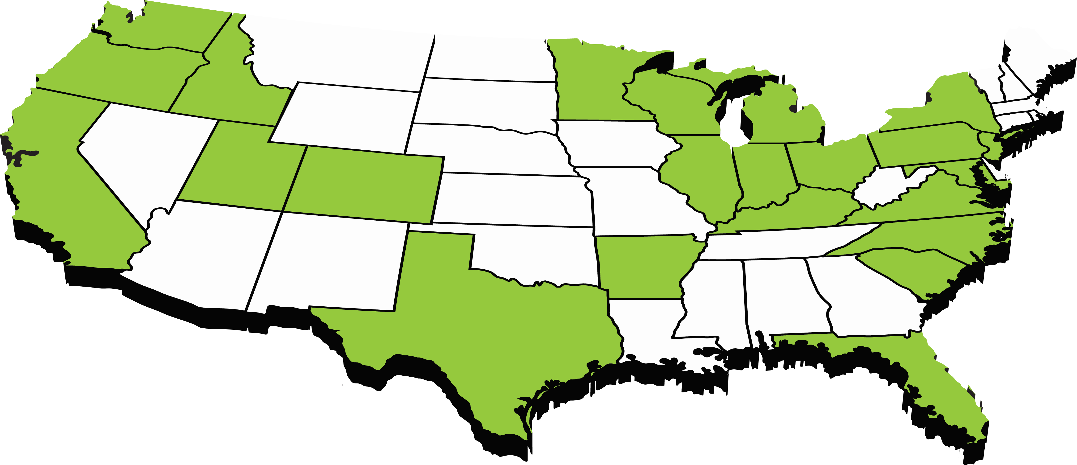
TRUELACROSSE.COM
Connecting True
220+ Programs
120+ SENIOR Program Directors
Hundreds of PART-TIME STAFF
All-Region Games 2026

Slide 14
TRUELACROSSE.COM
The Event of the Year
Ready to be part of history in the making?
The All-Region Games offer an unparalleled lacrosse experience that combines competitive play with exceptional exposure. For players, this is the chance to showcase their skills in front of some of the most respected collegiate coaches and influential figures in the sport. The event is designed to maximize visibility and offer valuable feedback, while also fostering an environment of growth and competition.
The All-Region Games are also an essential part of True Lacrosse’s athlete development pipeline. Players will be able to rise through the ranks of our state and national programs, opening the door to exciting opportunities within the True National team.
All-Region Games 2026

Slide 15
TRUELACROSSE.COM
Next Steps & Registration
Get Involved in the All-Region Games Today
The All-Region Games are by invitation only, so if you’ve been selected, we encourage you to register early and secure your spot in this prestigious event. Registration details, including deadlines and instructions, are available through True Lacrosse’s official channels. For any questions or more information about the event, please don’t hesitate to contact us directly.
Join us at the 2026 All-Region Games in sunny Florida and take the next step in your lacrosse journey. We look forward to seeing you there!
All-Region Games 2026

